Slide 1

Course: Java programming i
Mr. Chenda Sovisal

Slide 2
Chapter V
Strings and Strings manipulation

Slide 3

Agenda
Introduction to Strings in Java
String Creation and Initialization
String Methods and Operations
String Manipulation Techniques
StringBuilder Class

Slide 4
Introduction to Strings in Java

Slide 5
I. Introduction to Strings in Java
String is an object that represents a sequence of characters. It is a widely used data type for storing and manipulating textual data.
Strings are immutable - their values cannot be changed once created.

Slide 6
String Creation and Initialization

Slide 7
II. String Creation and Initialization
Syntax for declaring and initializing strings
String str1 = "Hello";
String str2 = new String("World");

Slide 8
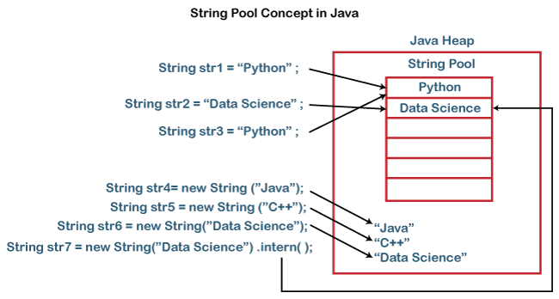

Slide 9
String Methods and Operations

Slide 10
III. String Methods and Operations
Commonly used methods for string manipulation:
length() : This method returns the length of the string, i.e., the number of characters in the string. Ex:
String str = "Hello World";
int length = str.length(); // length = 11
charAt(index) : This method returns the character at the specified index in the string. The index starts from 0. Ex:
String str = "Hello";
char ch = str.charAt(1); // ch = 'e'

Slide 11
III. String Methods and Operations
substring(beginIndex) : This method returns a new string that is a substring of the original string, starting from the specified beginIndex and extending to the end of the string. Ex:
String str = "Hello World";
String substr = str.substring(6); // substr = "World"
substring(beginIndex, endIndex) : This method returns a new string that is a substring of the original string, starting from the beginIndex and ending at endIndex - 1. Ex:
String str = "Hello World";
String substr = str.substring(6, 11); // substr = "World"

Slide 12
III. String Methods and Operations
indexOf(str) : This method returns the index of the first occurrence of the specified substring within the string. If the substring is not found, it returns -1. Ex:
String str = "Hello World";
int index = str.indexOf("World"); // index = 6
lastIndexOf(str) : This method returns the index of the last occurrence of the specified substring within the string. If the substring is not found, it returns -1. Ex:
String str = "Hello World";
int index = str.lastIndexOf("o"); // index = 7

Slide 13
III. String Methods and Operations
String comparison using methods:
equals(str) : This method compares the content of the current string with the content of the specified object for equality. It returns true if the contents are equal, and false otherwise. Ex:
String str1 = "Hello";
String str2 = "Hello";
boolean isEqual = str1.equals(str2); // isEqual = true

Slide 14
III. String Methods and Operations
equalsIgnoreCase(str) : This method compares the content of the current string with the content of another string for equality, ignoring the case of the characters. It returns true if the contents are equal (ignoring case), and false otherwise. Ex:
String str1 = "Hello";
String str2 = "hello";
boolean isEqual = str1.equalsIgnoreCase(str2); // isEqual = true

Slide 15
III. String Methods and Operations
compareTo(str) : This method compares two strings lexicographically. It returns an integer value that indicates the relationship between the strings.
If the current string is lexicographically less than the anotherString, it returns a negative value.
If the current string is lexicographically greater than the anotherString, it returns a positive value.
If the strings are equal, it returns 0.
Ex:
String str1 = "apple";
String str2 = "banana";
int result = str1.compareTo(str2); // result < 0 (negative value)

Slide 16
String Manipulation Techniques

Slide 17
IV. String Manipulation Techniques
There are two ways in order to combine two strings or multiple string together:
Concatenation using + operator
Concatenation using concat(str) method

Slide 18
IV. String Manipulation Techniques
In order to make a text in String to be all Capital or Small caps:
toUpperCase()
toLowerCase()
Ex:
String str = "Hello World";
String upperCaseStr = str.toUpperCase(); // "HELLO WORLD"
String lowerCaseStr = str.toLowerCase(); // "hello world"

Slide 19
IV. String Manipulation Techniques
trim(str) : method to eliminate leading and trailing whitespaces from a string.
Ex:
String str = " Hello World ";
String trimmedStr = str.trim(); // "Hello World"

Slide 20
IV. String Manipulation Techniques
split(str) : method to split a string into an array of substrings based on a specified delimiter.
Ex:
String str = "Java is awesome";
String[] parts = str.split(" "); // ["Java", "is", "awesome"]

Slide 21
StringBuilder Class

Slide 22
V. StringBuilder Class
StringBuilder is preferred for efficient string concatenation when dealing with multiple string manipulations.
StringBuilder is mutable, allowing modifications to the existing string buffer without creating new objects for each manipulation operation.
By using StringBuilder methods like append(), developers can efficiently modify strings without the overhead of creating numerous string objects.
StringBuilder is preferred for efficient string concatenation when dealing with multiple string manipulations.
StringBuilder is mutable, allowing modifications to the existing string buffer without creating new objects for each manipulation operation.
By using StringBuilder methods like append(), developers can efficiently modify strings without the overhead of creating numerous string objects.

Slide 23
V. StringBuilder Class
StringBuilder is preferred for efficient string concatenation when dealing with multiple string manipulations.
StringBuilder is mutable, allowing modifications to the existing string buffer without creating new objects for each manipulation operation.
By using StringBuilder methods like append(), developers can efficiently modify strings without the overhead of creating numerous string objects.
StringBuilder stringBuilder = new StringBuilder();
stringBuilder.append("Hello");
stringBuilder.append(" ");
stringBuilder.append("World");
String result = stringBuilder.toString();
System.out.println("StringBuilder result: " + result); // Output: StringBuilder result: Hello World

Slide 24
The End of Chapter V

